Slide 1
EE 362: SUBSTATION & TRANSMISSION LINE DESIGN
Section 1:
SUBSTATION DESIGN
Dr. E. K. ANTO

Slide 2
Presentation Outline
DEFINITION of a substation
COMPONENTS / elements of a substation
TYPES of substation
Substation LAYOUT and operation
BUSBAR SYSTEMS and switching arrangements
SELECTING A BUSBAR SYSTEM

Slide 3
DEFINITION OF A SUBSTATION

Slide 4
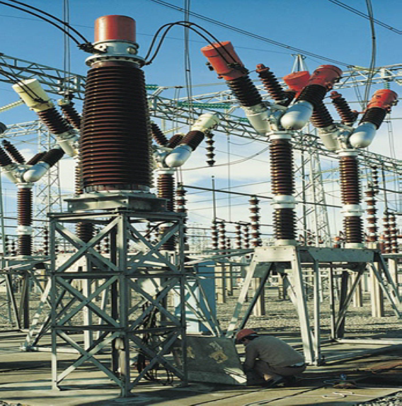
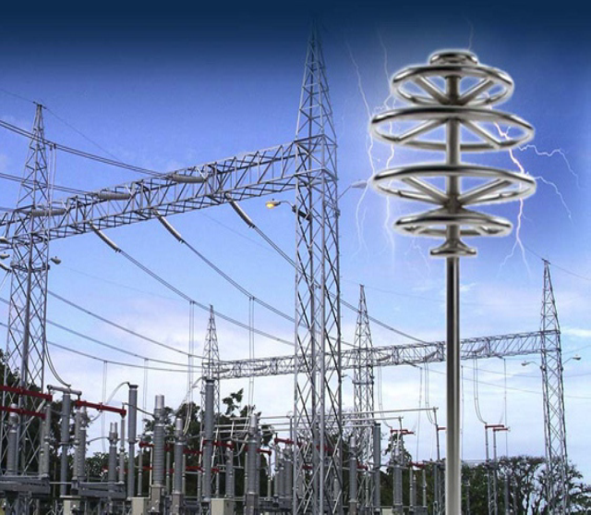
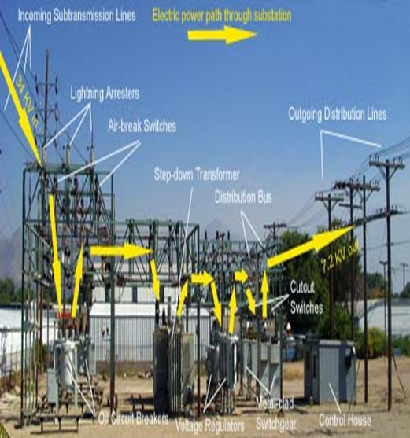
1.1: Definition of a Substation (1/1)
Substation - is
an assembly of a number of switchgear components
used to direct the flow of electrical energy in a power system.

Slide 5
COMPONENTS OF A SUBSTATION

Slide 6
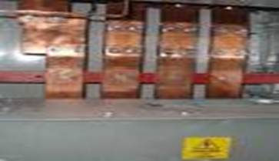
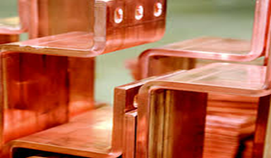
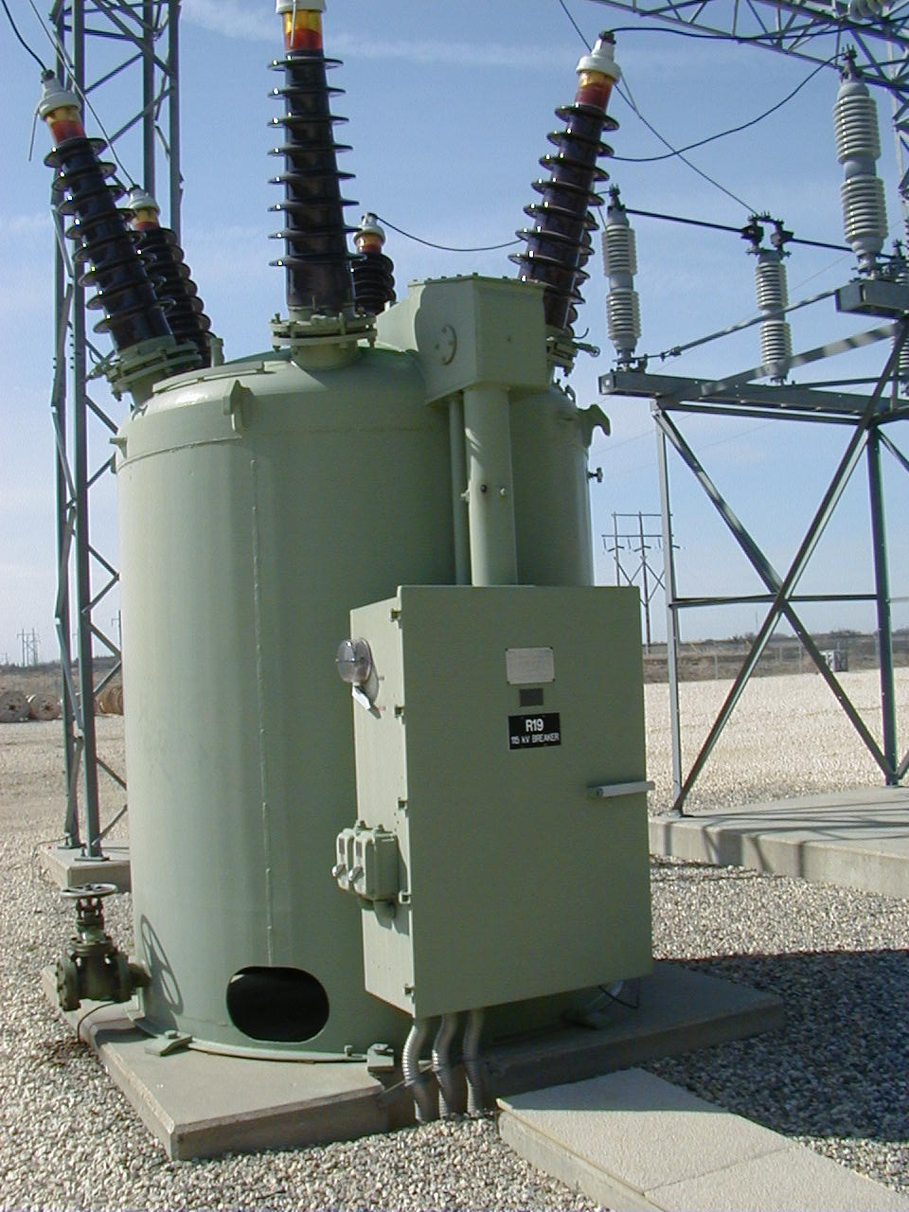
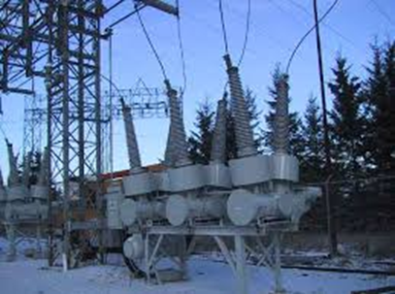
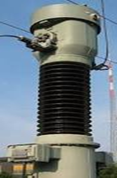
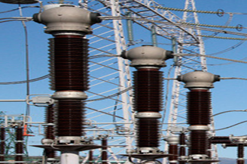
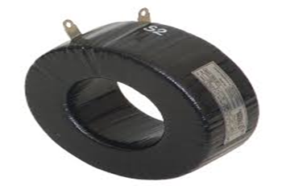
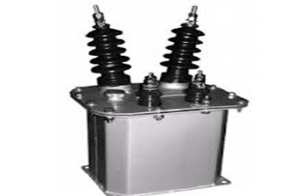
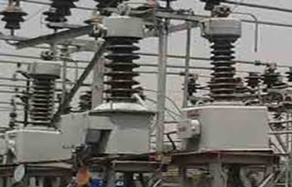
1.2: Components of a Substation (1/3)
1. Section of busbar(s):
2. Switching devices (disconnects/isolators, circuit breakers - CBs):
3. Instrument transformers (Current transformers – CTs; Voltage transformers – VTs)

Slide 7
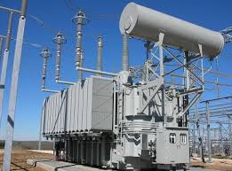
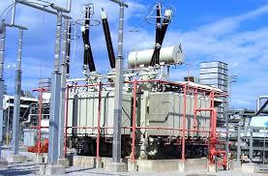
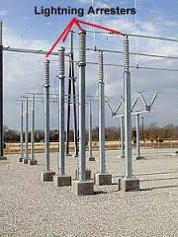
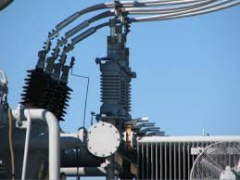
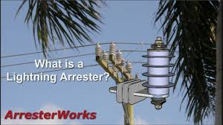
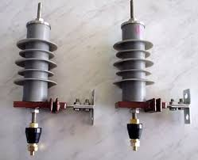
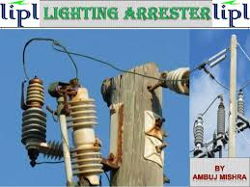
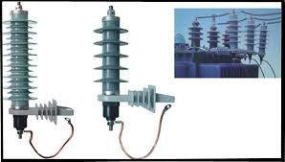
1.2: Components of a substation (2/3)
Power Transformers
Protective devices (Lightning arresters/surge diverters, earthing grids, fuses, etc.)

Slide 8
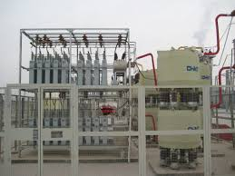
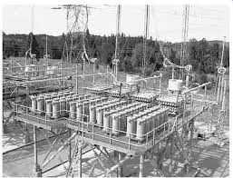
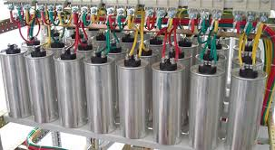
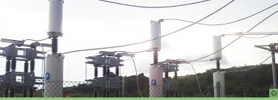
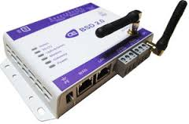
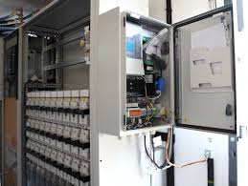
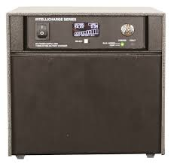
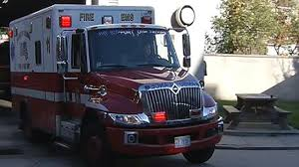
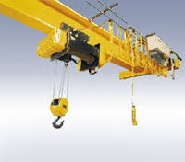
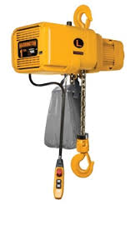
1.2: Components of a substation (3/3)
Voltage regulating devices (Shunt and series capacitors, voltage regulators)
Telecontrol systems
Auxiliaries (DC supply backups, fire fighting equipment, overhead cranes, etc.)

Slide 9
TYPES OF SUBSTATION

Slide 10
1.3: Types of substation (1/2)
There are a NUMBER OF TYPES to consider.
Step-up Substation – mainly for stepping up voltage for purposes of transmission.
Primary Substation – the highest in terms of hierarchy, voltage level and importance;
E.g., Main GRIDCo substation (161 kV) or
ECG substation points (33 kV) where they obtain from GRIDCo;
Generally, this substation has all the substation elements in place
Secondary Substation – next level after the Primary; e.g., ECG 11 kV substations or Main Power Supply Point for a customer, say, KNUST

Slide 11
1.3: Types of substation (2/2)
Distribution Substation – closest to the end-user; e.g., Engineering/Independence Hall/Science Substations (500 kVA, 11/0.433 kV) at KNUST
Bulk Supply Substation – often called bulk supply points (BSPs) where bulk power is supplied. e.g., GRIDCo substations at Ridge and Anwomaso in Kumasi
Industrial/Mining Substation – dedicated to supply power to the industries/mines
Rural Substation – for rural customers; least in the hierarchy; may have only a few of the substation elements (transformer, busbar, fuses, arrester)

Slide 12
LAYOUT OF SUBSTATION

Slide 13
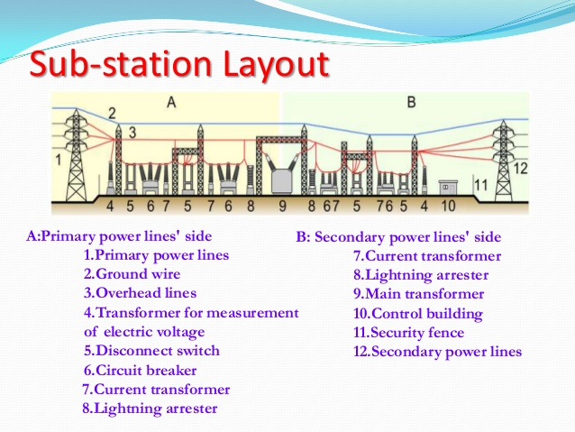
1.4: Layout of a Substation (1/2)
Layout is basically arranging a number of switchgear components in an ordered pattern governed by their function and by rules of spatial relationship

Slide 14
1.4: Layout of Substation (2/2): Considerations that affect substation layout
Spatial relationships of equipment
Maintenance zoning
Electrical separations
Limits imposed by the nature of the site
Type of substation - indoor or outdoor
Aesthetic considerations
Planning authority requirements

Slide 15
1.4.1: Layout of Substation: Spatial relationships
Four (4)clearance distances govern the spacing of components and conductors
1)Earth clearance: between live parts and earthed structures, walls, screens and ground
2)Phase clearance: between live parts of different phases
3)Isolating distance: between terminals of an isolator or connections thereto; also applies between connections to the terminals of a CB.
4)Section clearance: between live parts and the limits of a maintenance zone (work section).

Slide 16
1.4.2: Layout of Substation: Maintenance Zoning
It is necessary at the outset to have a clear idea of how:
the various items of equipment are to be grouped,
they are to be isolated and physically separated from neighboring live equipment and
safe access to them is to be achieved.

Slide 17
1.4.3: Layout of Substation: Electrical Separations
Fundamentally, at least three such electrical separations per phase are needed in a circuit.
between the terminals of the busbar isolator(s) or their connections
between the terminals of the CB or their connections
between the terminals of the feeder isolator or their connections
Additional separations may be needed to obtain phase clearances at points where conductors of different phase cross.

Slide 18
1.4.4: Layout of Substation: Site Limitations
These include such obvious factors as:
1. Limited ground area or a peculiarly shaped site, often imposed by built-up areas.
2. Restrictions on the position and direction of line entries, and
3. Need to integrate the substation with other projects such as power stations, or buildings that house low-voltage switchgear or other equipment.

Slide 19
1.4.5: Layout of Substation: Type - Indoor or Outdoor
The design to put EHV open-type switchgear indoors or outdoors is usually influenced by one or more of the following FACTORS:
Atmospheric pollution
Ease, safety and comfort in operation and maintenance
Site area
Aesthetic considerations
Planning Authority requirements

Slide 20
1.4.6: Layout of Substation: Aesthetic considerations
The aesthetic considerations mainly look at beautification requirements

Slide 21
1.4.7: Layout of Substation: Planning Authorities Requirements
The Planning Authority requirements must be observed, particularly with future considerations in mind

Slide 22
BUSBAR ARRANGEMENT SYSTEMS

Slide 23
1.5: Busbar systems (1/3)
The simplest way to join a number of circuits together is to attach them (like branch) to a single conductor called busbar.
A number of busbar arrangements have evolved over the years, for the FOLLOWING REASONS:
To improve security and reliability,
To facilitate maintenance
To increase flexibility of power system operation

Slide 24
1.5: Busbar systems (2/3)
Besides reliability, the types / complexities also have cost implications
Features common to busbar arrangements are
Bypassing facilities – to allow maintenance, especially of circuit breakers, and ensure continuity of supply
Current-limiting reactors – (i) Reactors are sometimes incorporated in a busbar system to reduce the fault level so that circuit breakers and other equipment of lower apparent-power (kVA) rating can be used ; (ii) they are usually connected between busbar sections.

Slide 25
1.5: Busbar systems (3/3)
Some of the BUSBAR ARRANGEMENTS to be considered are:
Radial/Single busbar system
Ring busbar system
Mesh busbar system
Interconnected system
Transfer busbar system
Duplicate/Double busbar system

Slide 26
RADIAL BUSBAR SYSTEM

Slide 27
1.5.1: Radial/Single system

Slide 28
1.5.1: Radial system: Merits and Demerits
Merits:
simplest configuration among the systems
less expensive of all the systems
Demerits
a circuit or transformer has to be taken out of service, to enable maintenance of the associated CB to be carried out.
less reliable

Slide 29
RING BUSBAR SYSTEM

Slide 30
1.5.2: Ring system
The ring system is used in distribution substations, but not for main transmission substations.

Slide 31
1.5.2: Ring system: Merits and Demerits
Merits:
gives rather better security than the single busbar system, because alternative routes round the busbar are available to outgoing circuits.
Also more reliable
Demerits
more complex and expensive than radial system.
requires more space than an equivalent single busbar system, particularly if the busbar-section isolators are duplicated
increases the fault levels, in the event of a fault, alternative routes exists to feed into the fault

Slide 32
MESH BUSBAR SYSTEM

Slide 33
1.5.3: Mesh system
In the mesh arrangement, the CBs, instead of being in the circuit tee offs, are in the busbar, which is of the ring type.
The operation of two circuit breakers is therefore required to connect or disconnect a circuit, and at disconnection, the ring is broken.

Slide 34
1.5.3: Mesh system: Merits and Demerits (1/2)
Merits:
It allows maintenance of any circuit without loss of supply or protection, and without added bypassing facilities
a fault at any point on the busbar causes loss of only one circuit.
a fault on a circuit breaker causes the loss of only two circuits, regardless of the total number of circuits
gives more enhanced security than the ring system.
employed in HV systems due to increased security,
has a higher utilization of circuits when fully developed

Slide 35
1.5.3: Mesh system: Merits and Demerits (2/2)
Demerits
more complex than ring system.
also increases the fault levels, in the event of a fault, alternative routes exists to feed into the fault
to cover all contingencies of switching, all the CBs and CTs in a mesh must be able to pass maximum current that may flow around the mesh, which is the equivalent of the busbar current rating in other types of busbar systems.
more expensive

Slide 36
INTERCONNECTED SYSTEM

Slide 37
1.5.4: Interconnected system

Slide 38
1.5.4: Interconnected system: Merits and Demerits
Merits:
increased security than the mesh system.
employed in HV systems due to the increased security
has a higher utilization of circuits when fully developed
Demerits
this arrangement requires more substation equipment overall (e.g. switchgear and electrical connections)
very expensive

Slide 39
TRANSFER BUSBAR SYSTEM

Slide 40
1.5.5: Transfer busbar system
The transfer busbar system is a single busbar system to which has been added facilities for bypassing any one circuit breaker on load.
In the event of a fault on the main busbar, loads can be transferred to the auxiliary busbar
Circuit breaker CB can also be isolated for routine maintenance or repair of main busbar, or examination after fault clearance, with the circuit still in operation.

Slide 41
1.5.5: Transfer busbar system: Merits and Demerits
Merits:
The bus-coupler circuit breaker enables on-load transfer of a circuit to be carried out from one (main) busbar to the other (auxiliary) busbar
It is also possible to select all circuits to one busbar, releasing the other busbar for maintenance works such as insulator cleaning
more secure than the single or radial system, since it permits segregation of circuits to minimize the effect of busbar faults
Demerits
more complex than radial system
more expensive than radial system

Slide 42
DUPLICATE/DOUBLE BUSBAR SYSTEM

Slide 43
1.5.6: Duplicate/Double busbar system
The duplicate busbar system is one of the commonest systems in use,
It makes it possible to cater for a wide variety of system operational requirements.
The number of incoming lines, generators, and transformers connected to a particular section of busbar or group of busbars, can be restricted to avoid excessive phase-earth or 3-phase fault currents.

Slide 44
1.5.6: Duplicate busbar system: Merits and Demerits
Merits:
The duplicate or double busbar system is most suitable for highly interconnected power supply system.
In the event of a fault on a busbar, it enables all the circuits on the faulty busbar to be transferred to the unfaulted busbar and reinstated immediately.
This reduces the loss time needed to operate the busbar-selector isolators of all the involved circuits, plus any time required for investigation and decision-making
more secure than the single or radial system
Demerits
more complex than radial system
more expensive than radial system

Slide 45
SELECTION OF BUSBAR SYSTEM

Slide 46
1.6: Selecting a busbar arrangement system
The selection of a busbar system must be considered in relation to the needs of the power system as a whole.
A fault on a busbar results in the disconnection of a large portion or area of a power system.
It is therefore not advisable to have too many generators on one section of busbar, and if the generators are of very large output, it is wise to limit the number to one.

Slide 47
1.6.1: Factors to consider in selecting a busbar system
The vulnerability of a substation to the various hazards.
The effect of atmospheric pollution on the frequency of maintenance.
Lightning and the possibility of sabotage (indoor or outdoor?).
In extreme form, these hazards may necessitate putting a substation indoors and this may affect the choice of busbar system.
The future growth and development of the supply system.
The need for economy in the early stages, coupled with the desire for the later introduction of more elaborate features, such as switching flexibility.
However, it must be noted that the reliability of supply during maintenance or faults is often the most important factor

Slide 48
EXERCISES

Slide 49
1.7: EXERCISES
Exercise 1
(a) Give a sketch of the radial and transfer bus system configurations, and discuss the merits and demerits of each.
(b)What is voltage regulation? State THREE means of achieving voltage regulation at a substation?
(c) Discuss the sequence of operation of circuit breakers and isolators in a switching operation.
(d) Mention any FIVE elements of a power substation, and explain their main functions in the substation.
Exercise 2
(a) Using a single line diagram illustration, discuss THREE disadvantages of the single busbar system. How can these demerits be minimized?
(b) Mention any FIVE considerations that influence a substation design.
(c) Using a single line diagram illustration, discuss THREE advantages of the transfer bus system.
(d) Briefly comment on any THREE considerations made when selecting a particular busbar system

Slide 50
1.7: EXERCISES (2)
Exercise 3
(a) Give a sketch each of the radial and transfer bus system configurations, and discuss TWO advantages and disadvantages of each.
(b) Explain what voltage regulation is, and state THREE means of achieving voltage regulation at a substation?
(c) State ONE main difference between circuit breakers and disconnecting switches as far as their switching operation is concerned? Why the need for two switching devices, in stead of one?
(d) If a transformer is to be switched out of a power system for maintenance purposes, what must be the correct sequence of operation of the circuit breaker and the disconnecting switch, and why?

Slide 51
End of Unit 1

